Slide 2

Parallel and Distributed Programming
Middle Project: 2D Heat Equation - Parallel Numerical Solution
Instructor: Dr. Vũ Văn Thiệu
Students: Lê Hoàng Long 20232099M
Mai Đức Trung 20232177M
Lê Ngọc Lâm 20232036M
Trần Như Thái 20194835

Slide 3
CONTENTS
Problem Specification
Algorithm
Parallel design
Result

Slide 4
Problem Specification
In this report, we will discuss the numerical solution of the two dimensional Heat Equation. An approximation to the solution function is calculated at discrete spatial mesh points, proceeding in discrete time steps.
The starting values are given by an initial value condition. We will first explain how to transform the differential equation into a finite difference equation, respectively a set of finite difference equations, that can be used to compute the approximate solution.
We will then modify this algorithm to parallelize this task on multiple processors using CUDA.

Slide 5
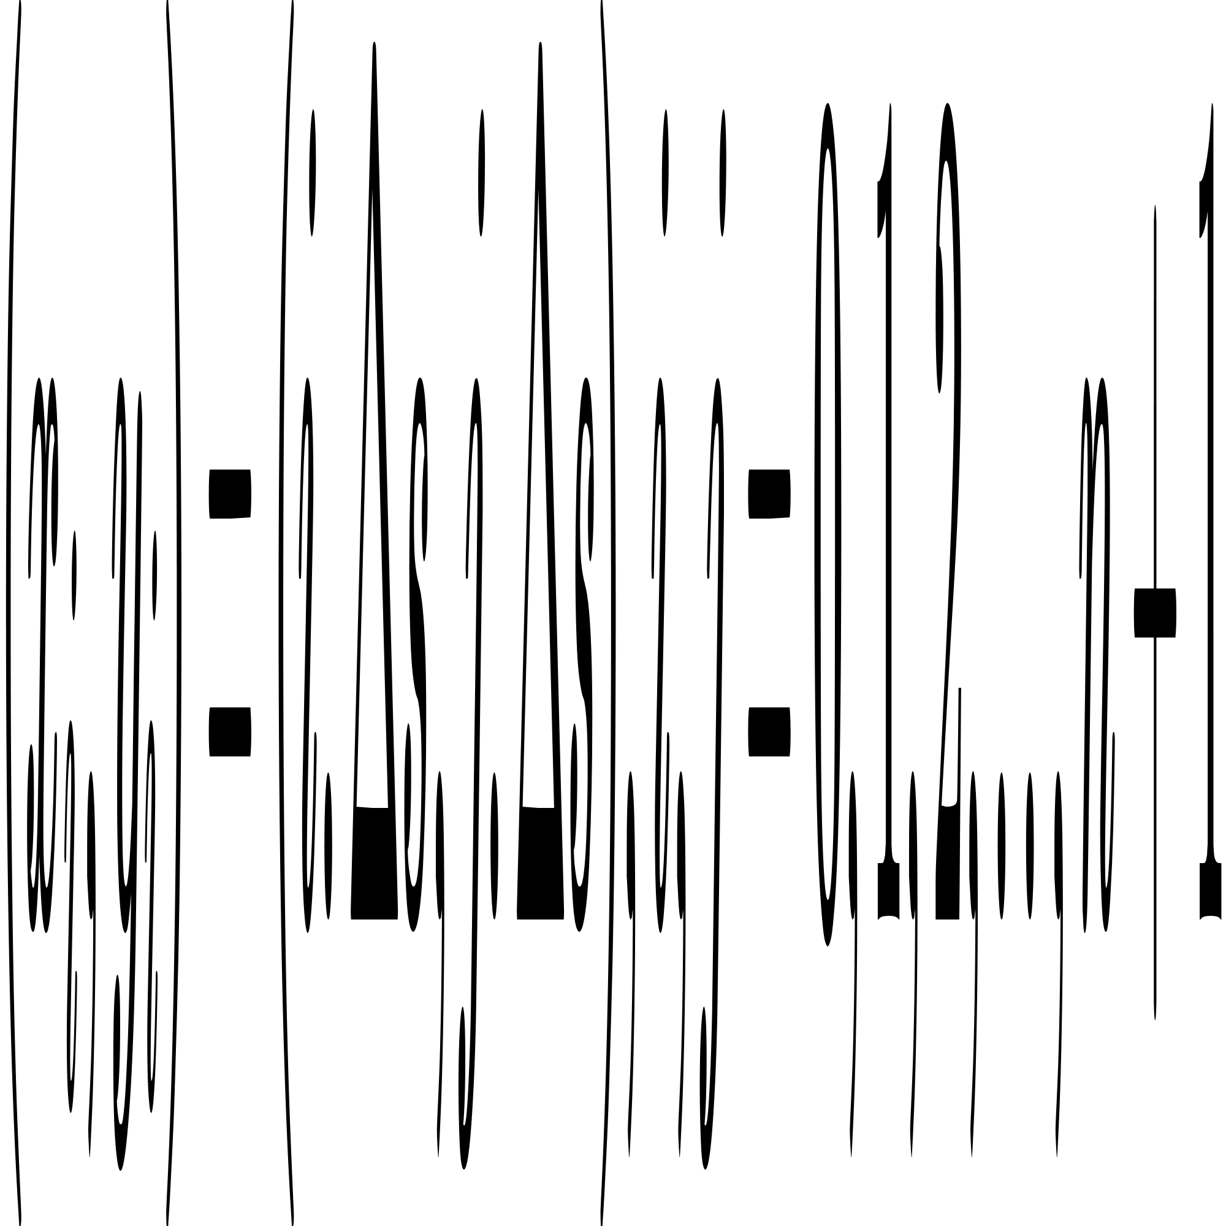
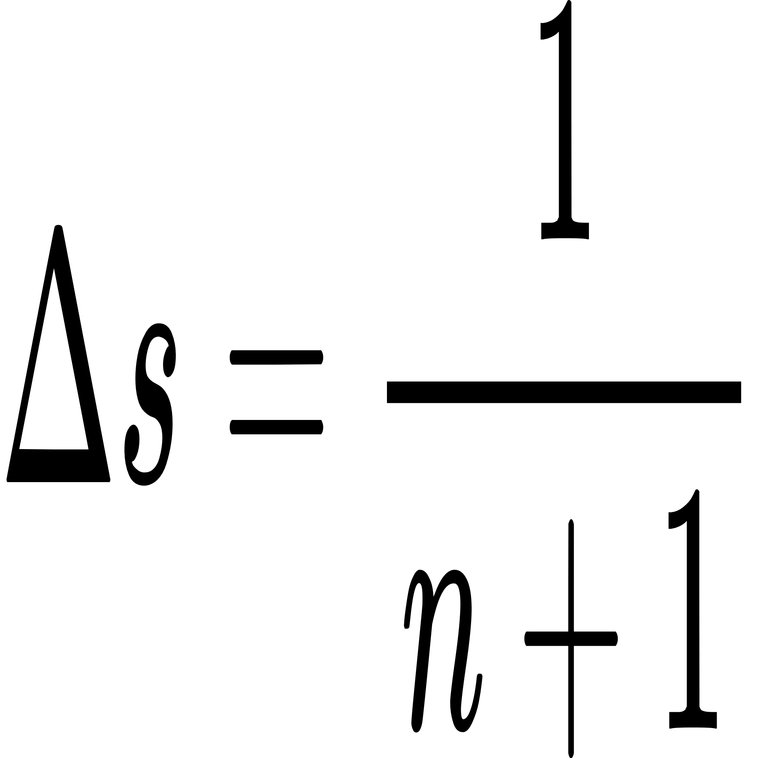
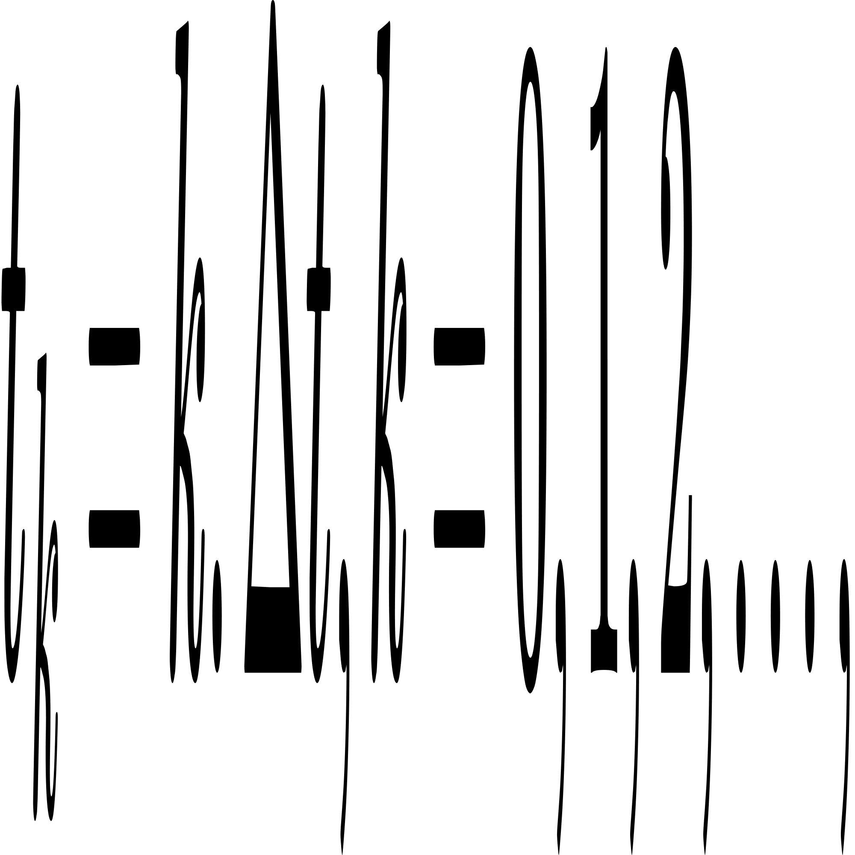
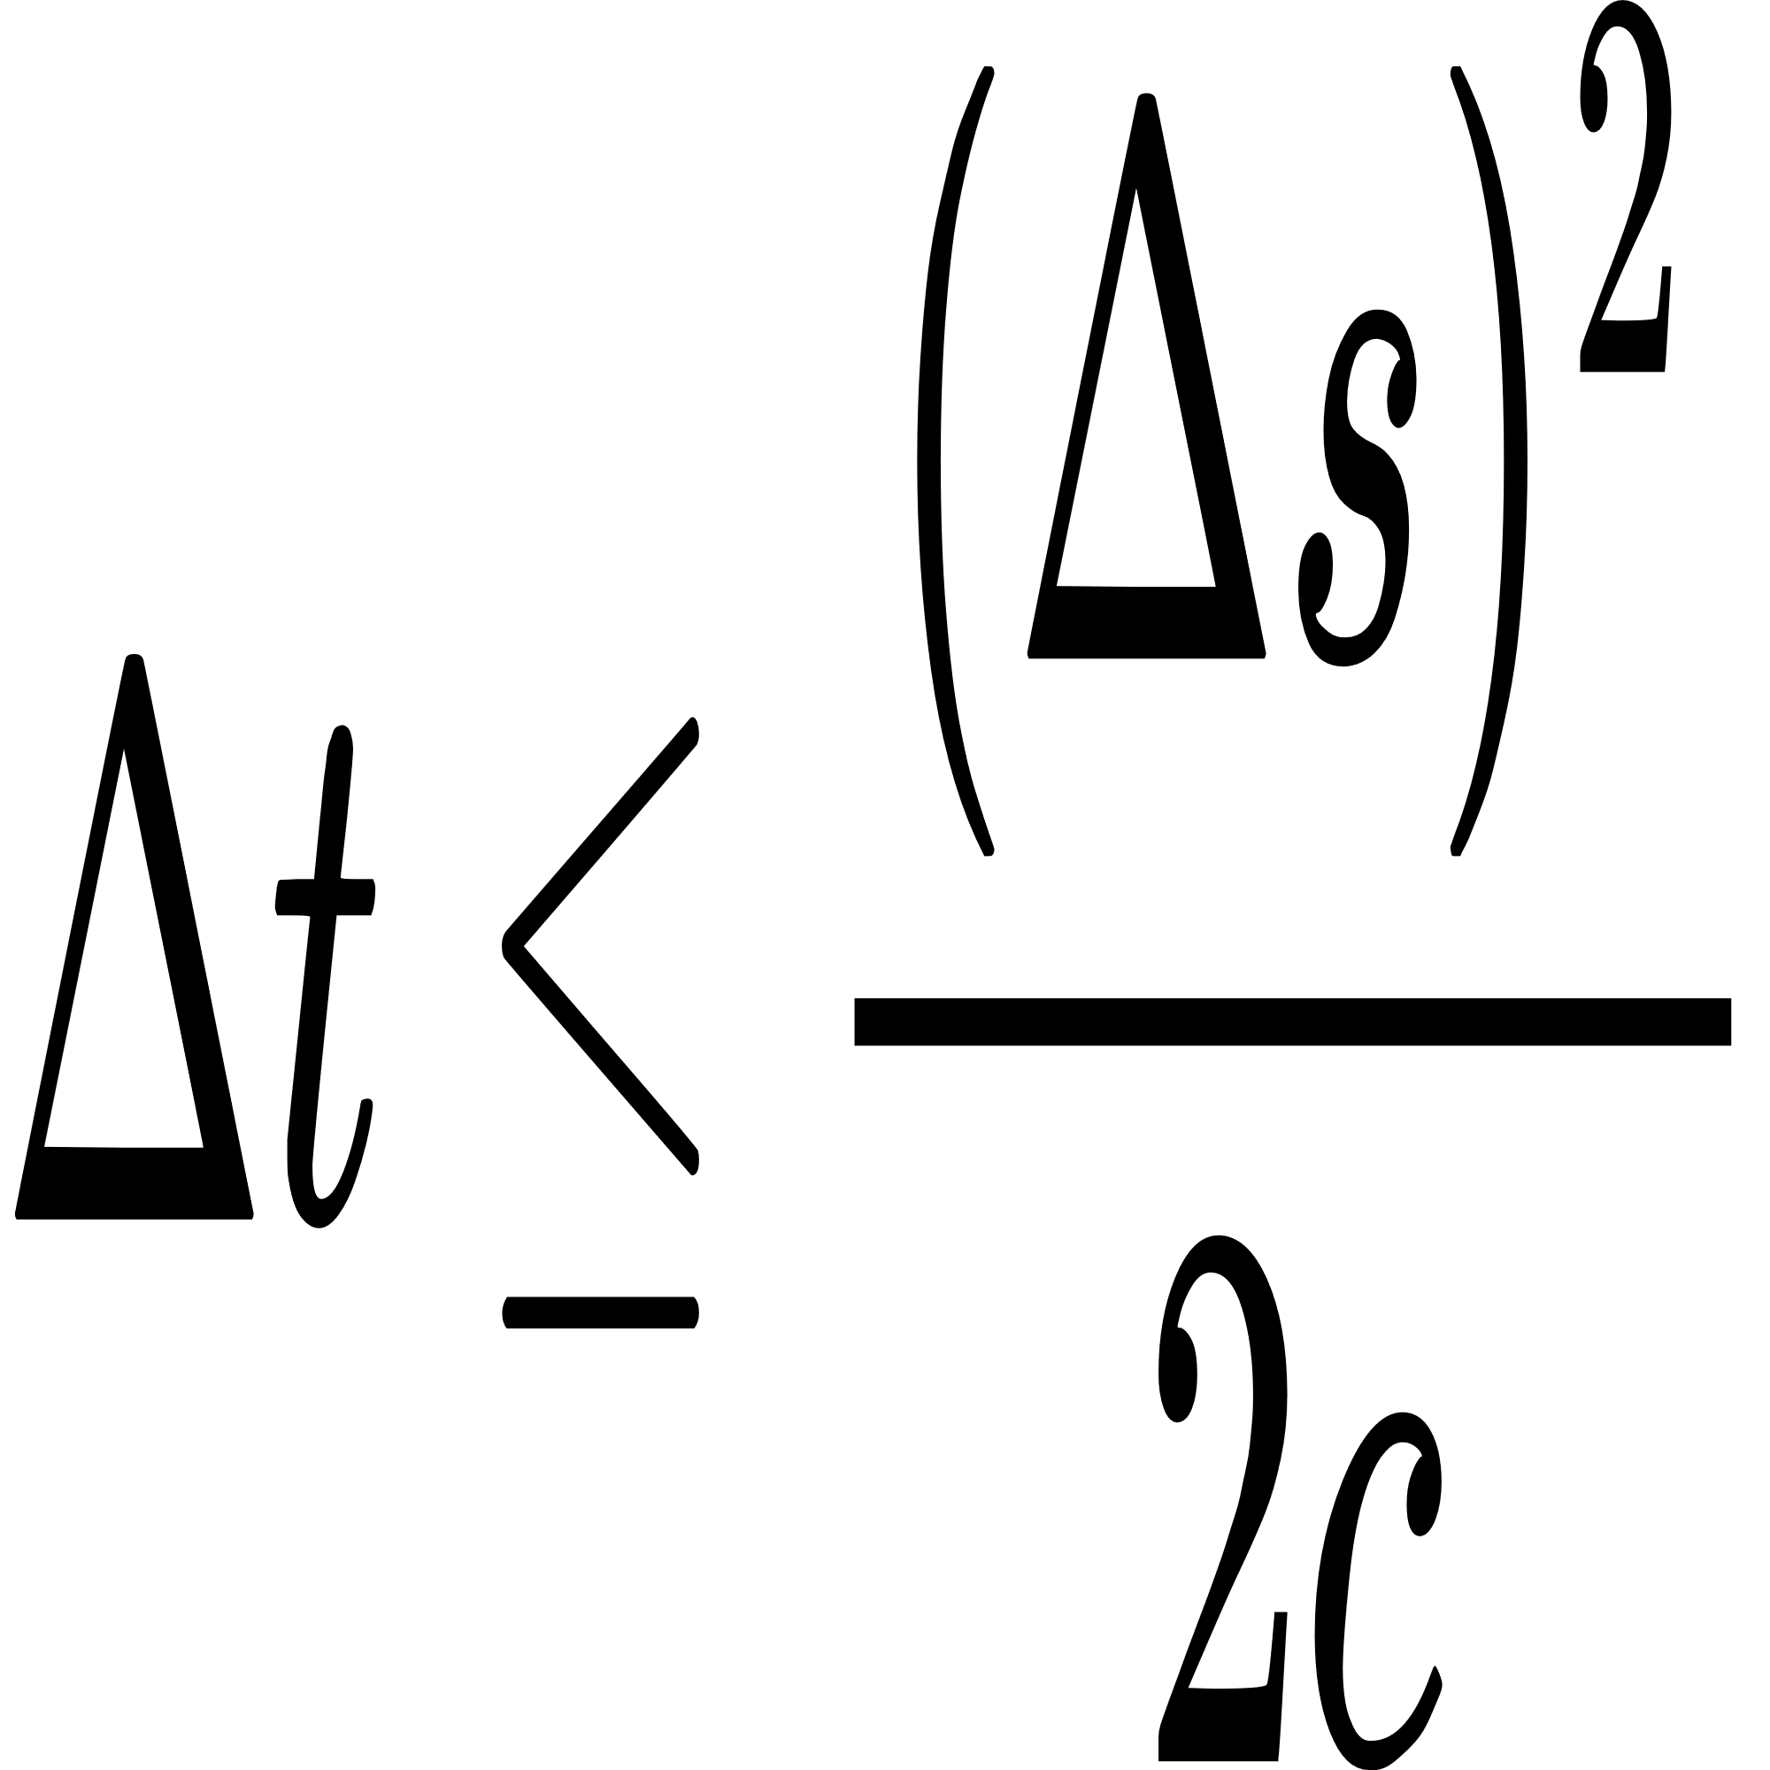
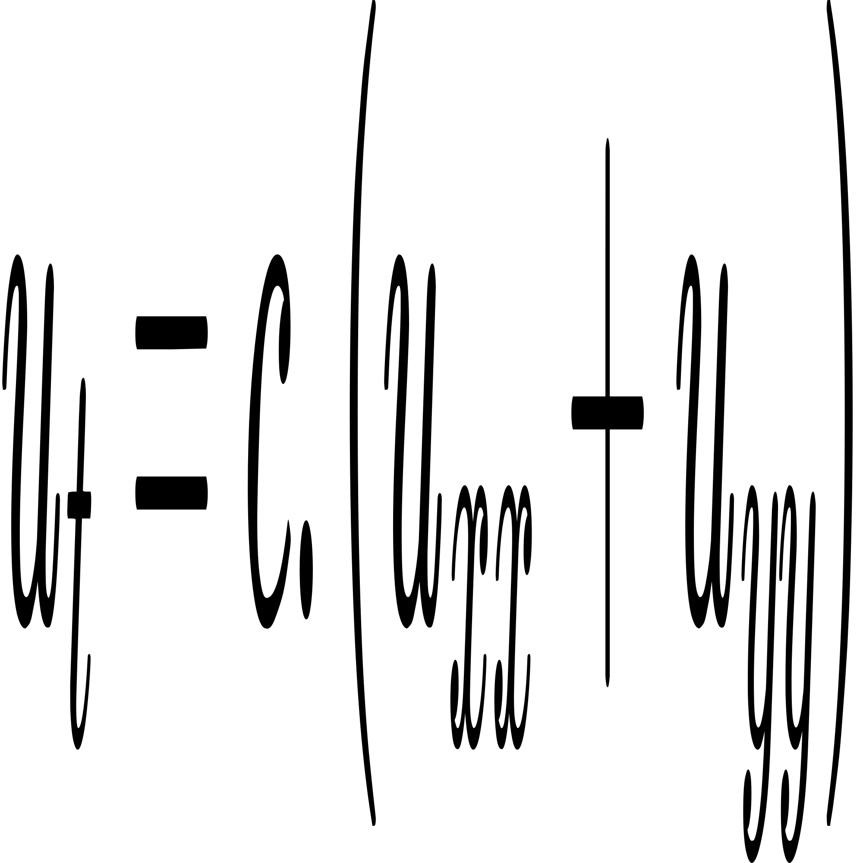
Problem Specification
We will first of all define spatial mesh points
where and temporal mesh points
For the Heat Equation, we know from theory that we have to obey the restriction
So the original differential equation
become

Slide 6
Algorithm
double[n+2][n+2] u_old, u_new;
double c, delta_t, delta_s;
Initialize u_old, u_new with initial values and boundary
conditions;
while (still time points to compute) {
for (int i = 1; i <= n; i++) {
for (int j = 1; j <= n; j++) {
u_new[i, j] = u_old[i, j] + c * delta_t/delta_s^2 *
(u_old[i+1, j] + u_old[i-1, j] - 4*u_old[i, j] +
u_old[i, j+1] + u_old[i, j-1]);
} //end of for
} // end of for
u_old = u_new;
} // end of while

Slide 7
Parallel design
Allocate memory space on host and device
Copy u_old from host to device
Initialize number of block and number of threads per block
Loop for T times
Run parallel block
Calculate value of the cell using data from u_old
Save the new value to the right cell in u_new
End parallel block
Wait until all thread are finished
Run parallel block
Copy a cell from u_new to u_old
End parallel block
End loop
Print the result

Slide 8
Source code
Collab link : https://colab.research.google.com/drive/1JAaWb5e0336NoreJK7zhGLWaa2lWtTzQ?usp=sharing

Slide 9
Result
parallel result
25.0 25.0 25.0 25.0 25.0 25.0 25.0 25.0 25.0 25.0 25.0 100.0
25.0 25.2 25.4 25.8 26.4 27.5 29.3 32.1 36.7 44.8 61.0 100.0
25.0 25.3 25.7 26.5 27.7 29.7 32.9 37.8 45.4 56.8 74.3 100.0
25.0 25.4 26.0 27.0 28.7 31.4 35.6 41.8 50.8 63.3 79.9 100.0
25.0 25.5 26.2 27.4 29.4 32.5 37.3 44.3 53.9 66.6 82.3 100.0
25.0 25.5 26.3 27.6 29.7 33.0 38.1 45.4 55.3 68.0 83.2 100.0
25.0 25.5 26.3 27.6 29.7 33.0 38.1 45.4 55.3 68.0 83.2 100.0
25.0 25.5 26.2 27.4 29.4 32.5 37.3 44.3 53.9 66.6 82.3 100.0
25.0 25.4 26.0 27.0 28.7 31.4 35.6 41.8 50.8 63.3 79.9 100.0
25.0 25.3 25.7 26.5 27.7 29.7 32.9 37.8 45.4 56.8 74.3 100.0
25.0 25.2 25.4 25.8 26.4 27.5 29.3 32.1 36.7 44.8 61.0 100.0
25.0 25.0 25.0 25.0 25.0 25.0 25.0 25.0 25.0 25.0 25.0 100.0

Slide 10
Result
serial result
25.0 25.0 25.0 25.0 25.0 25.0 25.0 25.0 25.0 25.0 25.0 100.0
25.0 25.2 25.4 25.8 26.4 27.5 29.3 32.1 36.7 44.8 61.0 100.0
25.0 25.3 25.7 26.5 27.7 29.7 32.9 37.8 45.4 56.8 74.3 100.0
25.0 25.4 26.0 27.0 28.7 31.4 35.6 41.8 50.8 63.3 79.9 100.0
25.0 25.5 26.2 27.4 29.4 32.5 37.3 44.3 53.9 66.6 82.3 100.0
25.0 25.5 26.3 27.6 29.7 33.0 38.1 45.4 55.3 68.0 83.2 100.0
25.0 25.5 26.3 27.6 29.7 33.0 38.1 45.4 55.3 68.0 83.2 100.0
25.0 25.5 26.2 27.4 29.4 32.5 37.3 44.3 53.9 66.6 82.3 100.0
25.0 25.4 26.0 27.0 28.7 31.4 35.6 41.8 50.8 63.3 79.9 100.0
25.0 25.3 25.7 26.5 27.7 29.7 32.9 37.8 45.4 56.8 74.3 100.0
25.0 25.2 25.4 25.8 26.4 27.5 29.3 32.1 36.7 44.8 61.0 100.0
25.0 25.0 25.0 25.0 25.0 25.0 25.0 25.0 25.0 25.0 25.0 100.0

Slide 11
THANK YOU !

